Slide 1
Sovereign borrowing outlook for 2022 and beyond: Navigating shocks and uncertainty with high debt
Cláudia Braz
Disclaimer: The views expressed here are my own and do not necessarily represent those of Banco de Portugal or the European System of Central Banks.
SUERF and BAFFI Bocconi e-lecture
27 June 2022

Slide 2
The report is very rich in terms of content and benefits from an unique database
1
Sovereign borrowing outlook for OECD countries
ESG practices and challenges from a public debt management perspective
2
3
Sovereign debt issuance trends in emerging-market economies

Slide 3
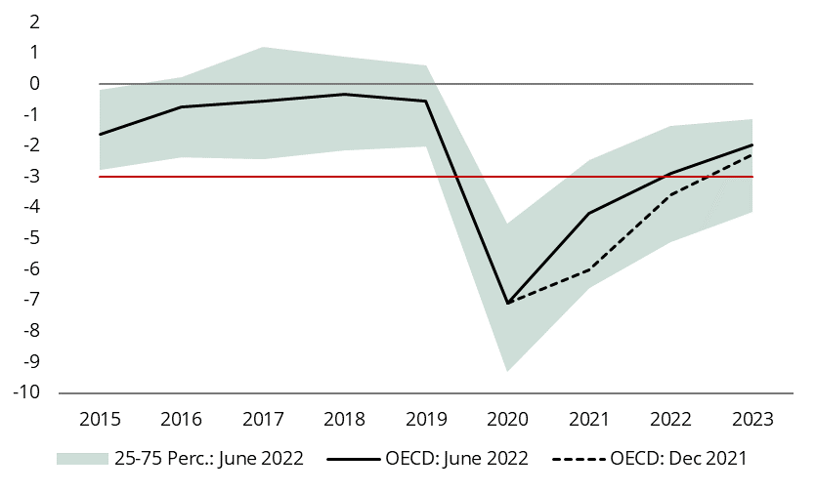
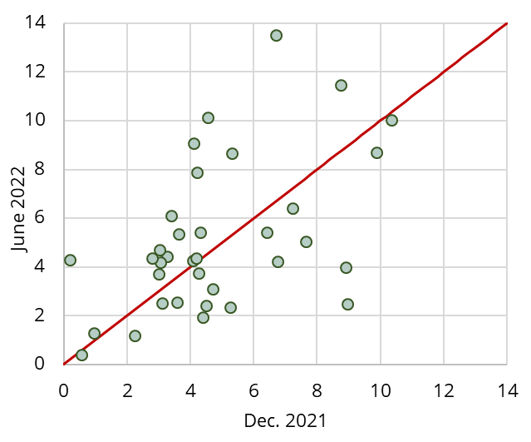
Rapidly changing circumstances are very challenging for those that have to elaborate forward looking reports...
Budget balance
(% of GDP)
Change in budget balance: 2020-2023
(pp of GDP)
Source: OECD Economic Outlook database.
Note: ‘OECD’ corresponds to a simple average based on countries budget balance ratios to GDP.
Source: OECD Economic Outlook database.
… but the implications regarding fiscal balances are not problematic so far.

Slide 4
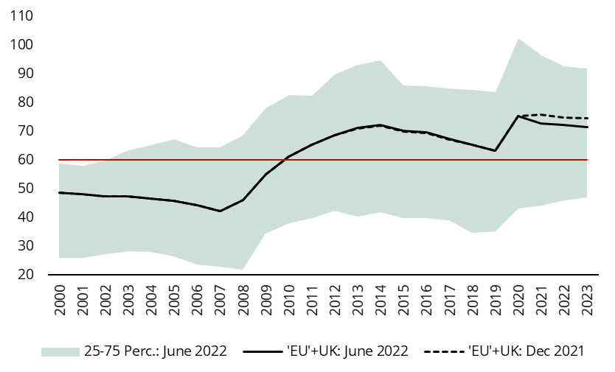
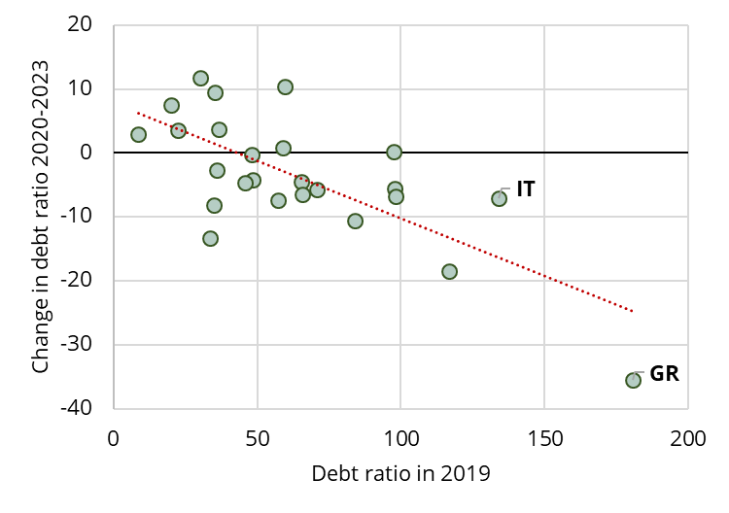
The prospects for debt ratios are also not deteriorating, in spite of high heterogeneity and uncertainty
Public debt
(% of GDP)
Source: OECD Economic Outlook database.
High debt countries may even record a faster reduction in debt ratios but gross financing needs are substantial

Slide 5
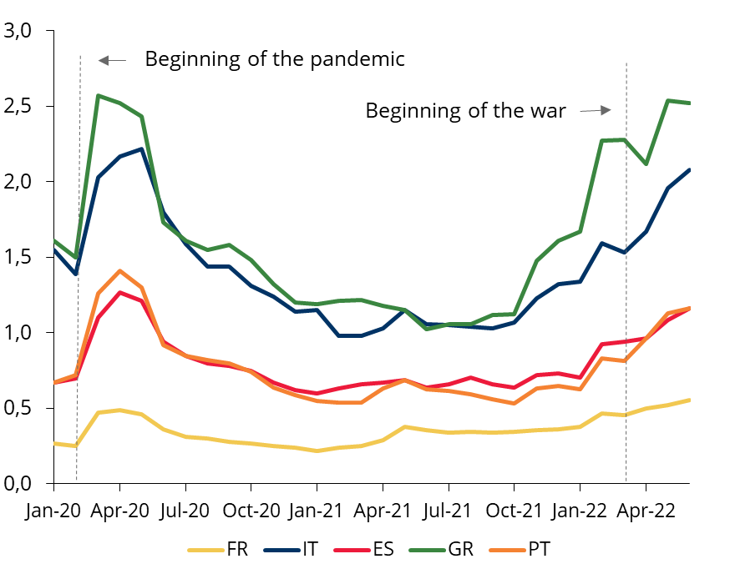
A couple of weeks ago, financial markets reacted adversely, penalising more vulnerable countries
Fragmentation risks subsist:
Financial markets reaction is unstable
Many factors concur to debt sustainability risks
The legacy of fiscal misconduct is significant
Sovereign spreads to 10-year German bonds
(%)
Prudent fiscal policies (3 T’s)
Fiscal rules

Slide 6
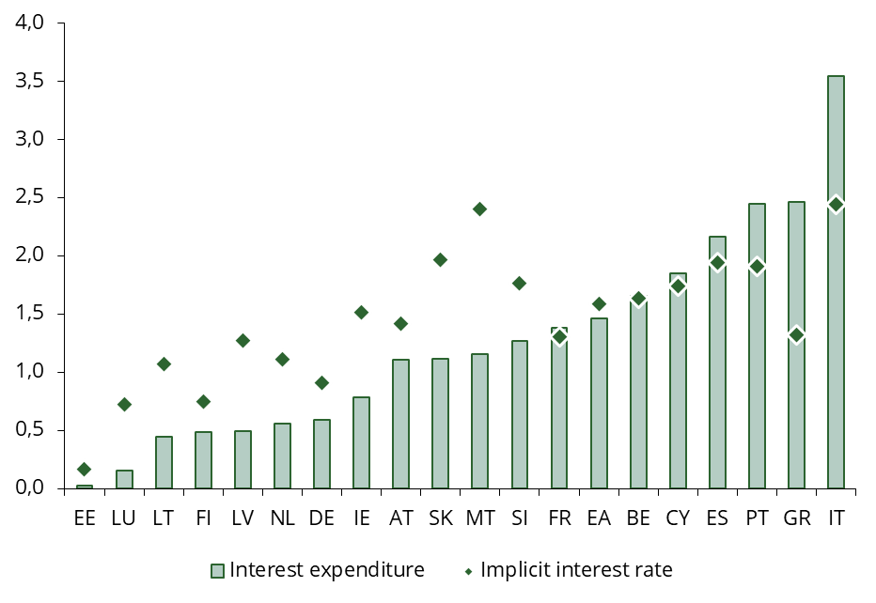
The impact of higher interest rates will be gradual and differentiated between countries, depending on the respective debt structure
Debt structure:
Fixed/variable rate (inflation indexation)
Maturity
Holders
Currency
Interest expenditure and implicit interest rate on public debt in the euro area
(% of GDP and %)
The ‘leeway’ associated to reducing interest payments (observed in the last years) will cease to exist

Slide 7
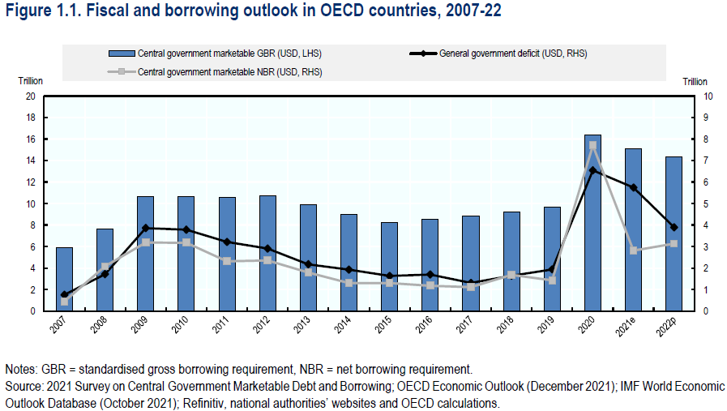
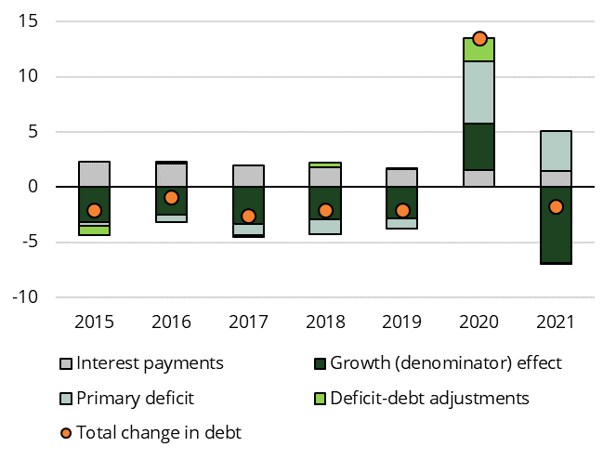
A suggestion for the next report ☺: collection of information on cash-buffers available for DMO’s
Breakdown in the change of the euro area debt ratio
(pp of GDP)
Differences between GG deficit and central government NBR:
Sectoral perimeter
National accounts versus cash-basis
Changes in cash-buffer
Other debt instruments

Slide 8
Thank you for the attention!

